Slide 1
Parsing-based Sarcasm Sentiment Recognition in Twitter Data
Santosh Kumar Bharti, Korra Sathya Babu, Sanjay Kumar Jena
2015 IEEE/ACM International Conference on Advances in Social Networks Analysis and Mining

Slide 2
Definition
The Macmillan English dictionary
“the activity of saying or writing the opposite of what you mean, or of speaking in a way intended to make someone else feel stupid or show them that you are angry”.
The Random House dictionary
“a harsh or bitter derision or irony” or “a sharply ironical taunt; sneering or cutting remark”.
The Collins English dictionary
“mocking, contemptuous, or ironic language intended to convey insults or scorn”.
Another definition of sarcasm, by Merriam-Webster
“a mode of satirical wit depending for its effect on bitter, caustic, and often ironic language that is usually directed against an individual”

Slide 3
Introduction
There are some features present in the text, that plays a vital role to identify sarcasm
Hyperbole(夸张)
Combination of features like interjection, intensifier, quotes and punctuation mark in a given text
The presence of intensifier in a sentence increases the probability of sarcasm. In a given text adjective and adverb act as an intensifier.
Few interjection words that are frequently used in a text, as wow, yay, yeah, oh, nah, aha, etc.
There are also some punctuation marks and quotes such as ?????, !!!!!, ‘ ’, ‘‘ ’’ that are commonly used in texts.
Lexical (词汇)
uni-gram, bi-gram, tri-gram and n-gram are useful to identify sarcasm[4].
Pragmatics(语用学?)
such as smiles and emoticons

Slide 4
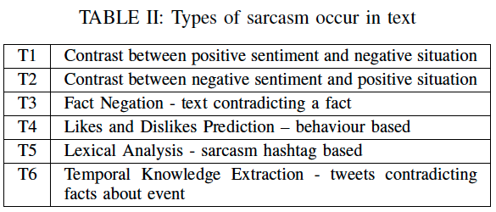
Types of Sarcasm
(i) when text sentiment conflict with text situation. (情感与场景冲突)
(ii) when text contradicts a fact. (与事实冲突)
(iii) when the authors likes and dislikes conflict with the text. (喜欢冲突)
(iv) when a text contains sarcasm hashtag at the end. (嘲讽标签结尾)
(v) when a text conflict with the fact about any event such as a festival, birthday, sports, etc. (与事件冲突)

Slide 5
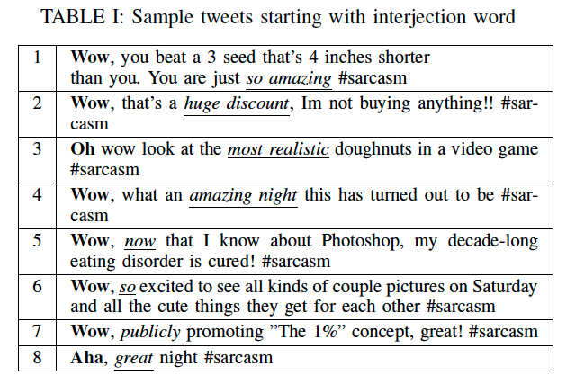
Pattern of Sarcasm
After analysis, we conclude that
if any tweet starts with interjection word and immediately followed by either adjective or adverb, it can be classified as sarcastic
shown in tweet numbers 5, 6, 7 and 8
If any tweet starts with interjection word and it contains adverb and immediately followed by adjective or vice-versa, can also be classified as sarcastic
shown in tweet numbers 1 and 3
In any tweet that starts with interjection word and contains either structure first adjective followed by a noun or first adverb followed by a verb (underlined italics) can also be classified as sarcastic
shown in tweet numbers 2 and 4
A new type of sarcasm text that having contradiction between negative sentiments and positive situation
such as, “I hate Australia in cricket, because they always win ”. #sarcasm

Slide 6
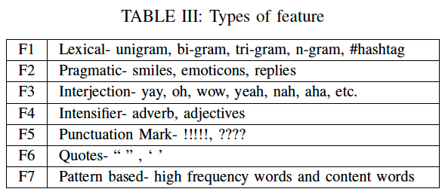
Types of Features
(i) Hashtag
if any text contains hashtag sarcasm, then its easy to identify the text as sarcastic.
(ii) lexical feature
uni-gram, bi-gram, tri-gram and n-gram
Ex: bi-gram “amazing night” people often say this phrase sarcastically.
(iii) Pragmatic feature
like emoticons, smiles, replies, etc.
(iv) Intensifier
Adverbs and adjectives are often used as intensifiers
such as fantastic weather, so pleased, etc.
(v) Interjection
words like wow, oh, uh etc.
punctuation mark, quotes, etc.
(vi) Some high frequency words

Slide 7
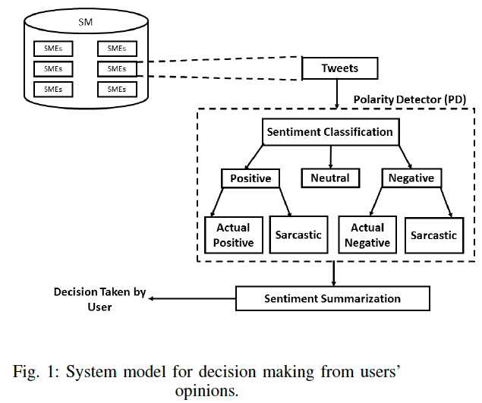
System model for decision making from users’ opinions
Social media (SM)
It is a social networking website (Facebook, Twitter, Amazon, etc.), where people use to write an opinion, reviews, and post some blogs, or micro-blogs about any social media entities.
Social media entities (SME)
An entity about which, users want to post and retrieve comments, tweets and give reviews on social media.
Polarity detector (PD)
A automated system which is capable to identify the actual sentiment or sarcasm sentiment from text.

Slide 8
Proposed Scheme
We observed that the authors have not yet worked on
T2 type of sarcasm (contrast between negative sentiment and positive situation)
and hyperbolic text that starts with interjection words
Based on these two limitations, two proposals are made.
1) A parsing based lexical generation algorithm (PBLGA)
to recognize sarcasm in both forms of tweets:
(a) contradiction of negative sentiment and positive situation
(b) contradiction of positive sentiment and negative situation.
2) An Interjection_word_start (IWS) algorithm is given to identify sarcasm in tweets that start with interjection words like wow, yay, etc.

Slide 9
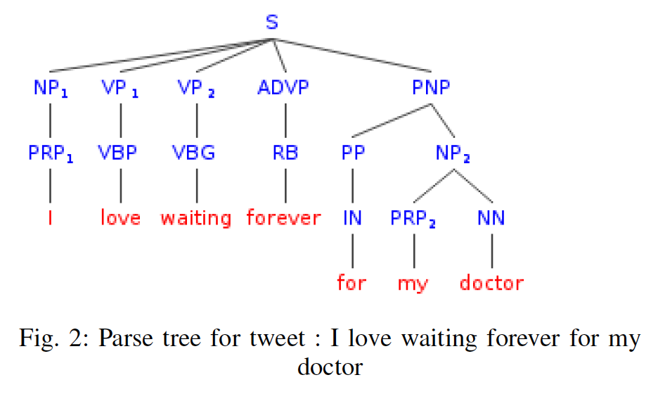
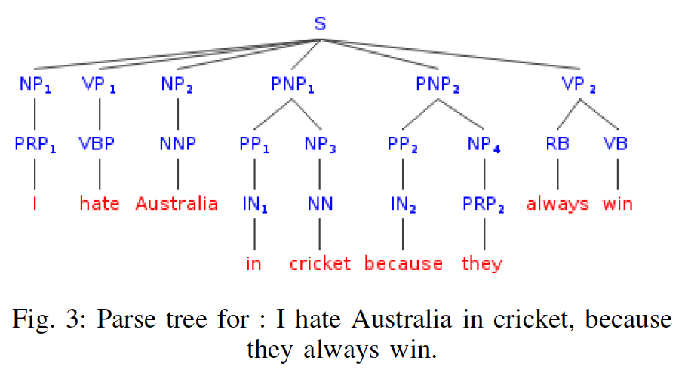
Parse

Slide 10
Algorithm 1: Parsing Based Lexical Generation Algorithm (PBLGA)
To learn sentiment phrase, if subset of parse contains either
(noun phrase followed by verb phrase) or
(adjective phrase) or
only (noun phrase)
then add the phrase into the sentiment file
To learn situation phrase, if subset of parse tree contains either
(verb phrase) or
(adverb phrase followed by verb phrase) or
(verb phrase followed by adverb phrase) or
(adjective phrase followed by verb phrase) or
(verb phrase followed by noun phrase) or
(verb phrase followed by adverb phrase followed by adjective phrase) or
(verb phrase followed by adjective phrase followed by noun phrase) or
(adverb phrase followed by adjective phrase followed by noun phrase)
then the algorithm add the phrase into situation file as shown in Algorithm 1.

Slide 11
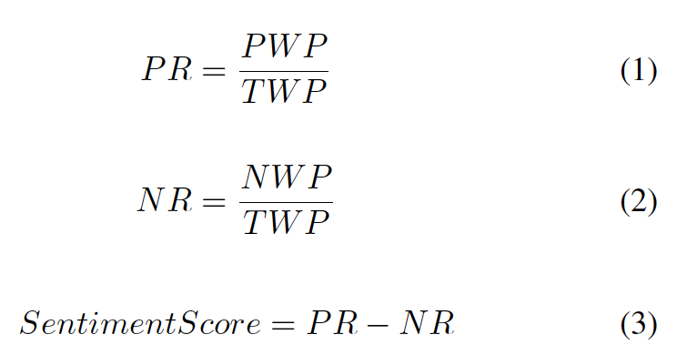
Sentiment score of Phrase
Notation:
PR= Positive Ratio, NR= Negative Ratio,
PWP= Number of Positive words in a given phrase,
NWP= Number of Negative words in a given phrase,
TWP = Total words in given phrase
(the only related tool mentioned is WordNet Affect)
If the sentiment score is greater than 0.0 in sentiment/situation file, algorithm add it in a positive sentiment/situation file otherwise in negative sentiment/situation file.
If the sentiment score is exactly 0.0 or phrase doesn’t contained any sentiment than we decide manually based on text context
Finally, we recognize sarcasm in new tweets by identifying contexts, that contain a positive sentiment in close proximity to a negative situation phrase.

Slide 12
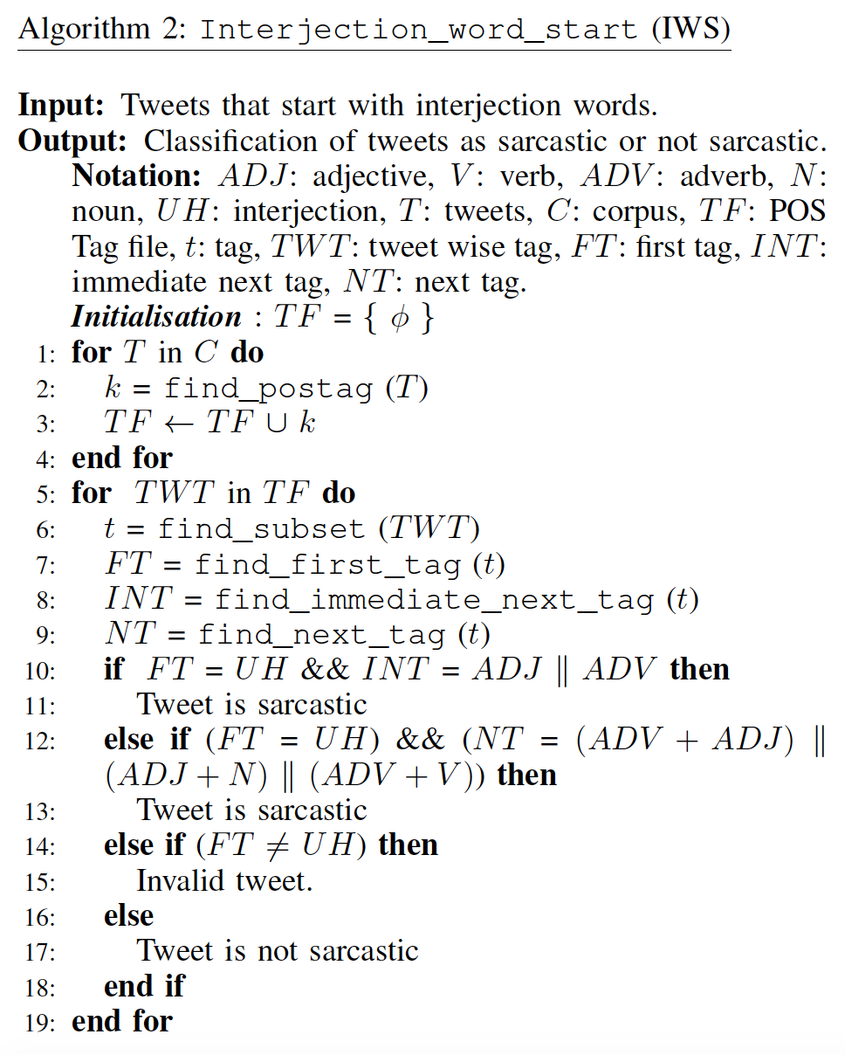
Algorithm 2: Interjection Word Start (IWS)

Slide 13
Database Collection
For training Algorithm 1
50000 tweets are collected
with the sarcasm hashtag (#sarcasm) from Twitter
with keyword love, amazing, good, hate, sad, happy, bad, hurt, awesome, excited, nice, great, sick, etc.
For testing
Tweets are collected in two categories
(i) tweets with sarcasm hashtag and
(ii) tweets without hashtag
To test Algorithm 1 (PBLGA)
1500 random tweets collected with sarcasm hashtag
1500 random tweets collected without hashtag
To test Algorithm 2 (IWS)
1000 tweets were collected with sarcasm hashtag
2500 tweets without any hashtag
both 1000 and 2500 tweets start with an interjection word
The collected tweets were preprocessed to remove hashtags, URL, @user, upper case word to lower case from the tweet corpus.
(Annotation is not mentioned)

Slide 14
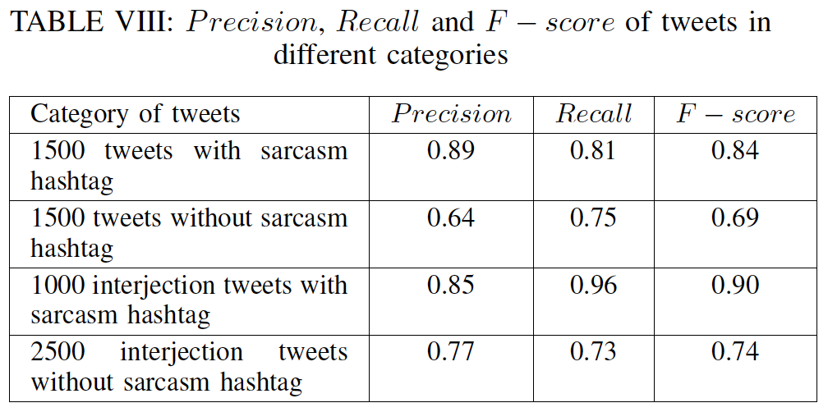
Results
Algorithm 1
Algorithm 2

Slide 15
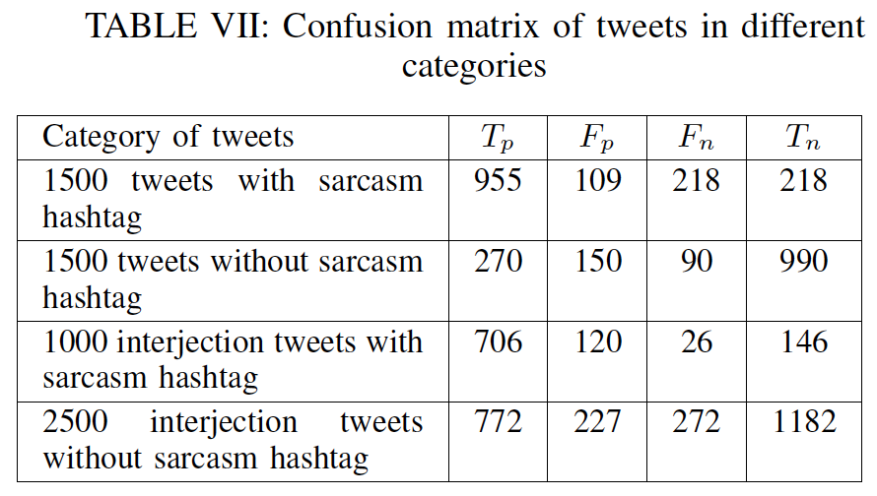
Results
True positive (Tp)
Number of tweets correctly identified as positive
False positive (Fp)
Number of negative tweets identified as positive
True negative (Tn)
Number of tweets correctly rejected
False negative (Fn)
Number of tweets incorrectly

Slide 16
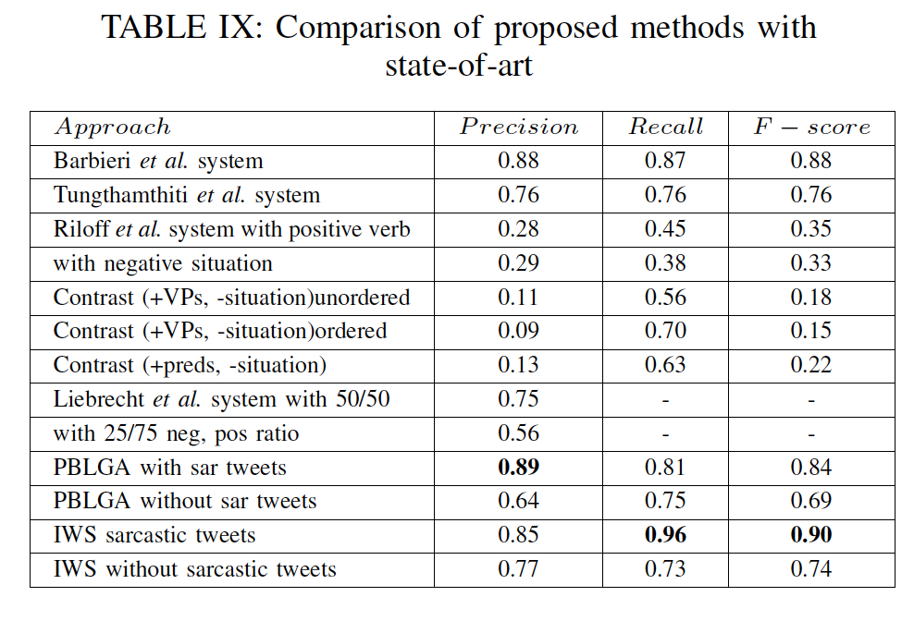
Results

